Slide 1

CaféVision ☕ AI-Powered Productivity Tracker “Built using Plainsight OpenFilter Framework”
👤 Agnel Salve | Northeastern University
👤Chinmay Sakhare | Northeastern University

Slide 2
Problem?
Manual observation = slow & inaccurate
No real-time productivity data
Customer wait times go unnoticed
📍Goal → Use vision AI to measure workflow efficiency

Slide 3

Solution Architecture
Camera Feed → YOLOv8 → Zone Logic → Overlay → Reporter
Each module = OpenFilter Filter Node
Modular, composable pipeline 🧩 Built with OpenFilter + Ultralytics + OpenCV + Python

Slide 4
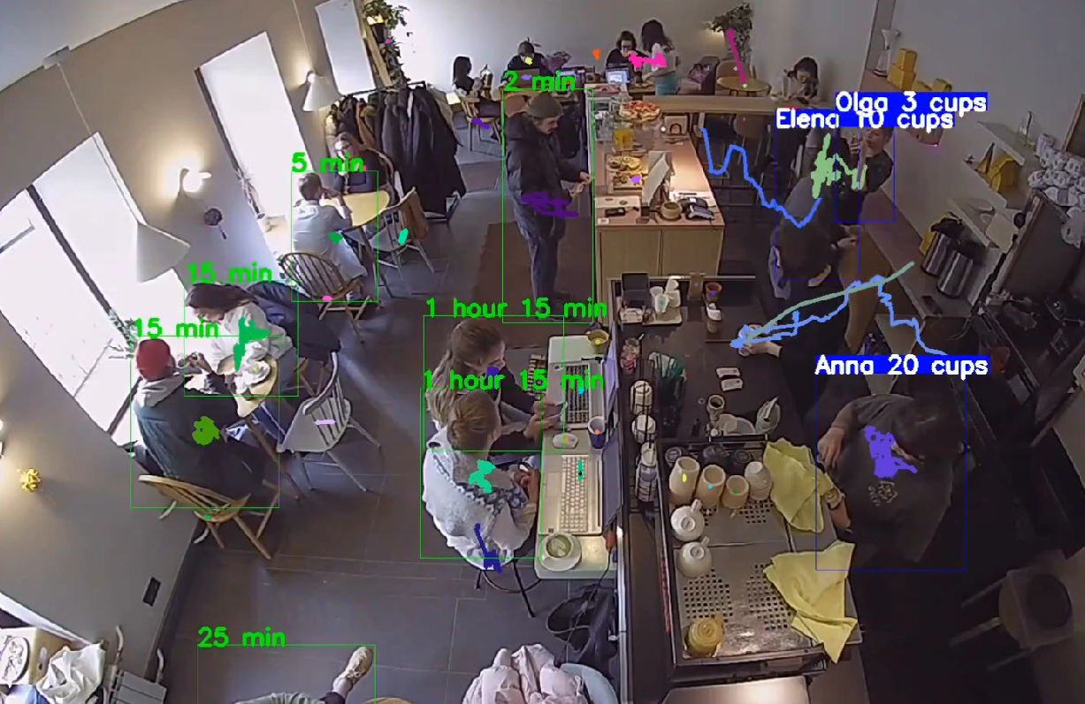
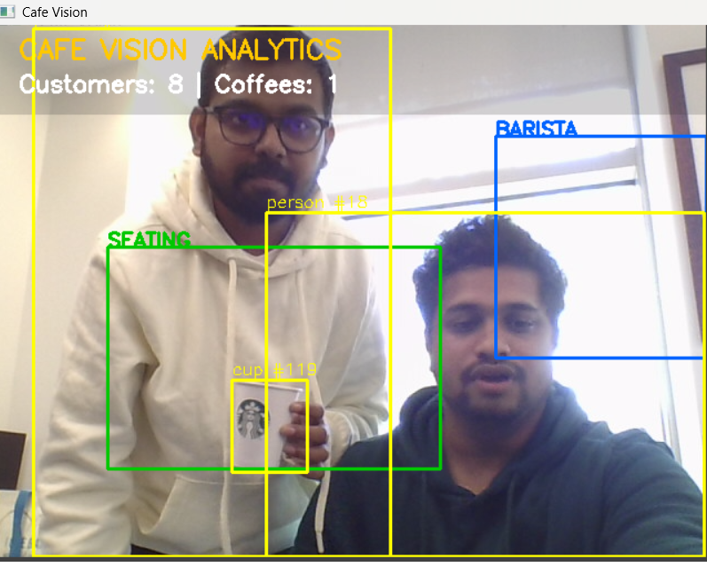
Demo Output
Show screenshot or short video (bounding boxes + overlays)
“Tracks customers and employees, calculates time per order and occupancy rate in real-time.”
Visual proof → data driven operations.

Slide 5

Impact & Next Steps
Reduce idle time & improve service speed
Scalable to other domains (retail, factories, events)
Future → add emotion detection + dashboard analytics ✨ “Built in 4 hours using OpenFilter’s enterprise-grade vision framework.”

